Slide 1
Sprint 1
BY MICHAEL TRINH, CHRIS TRUONG,

Slide 2
What we have so far
We planned out to have the feature on where we can input the player's name and include what class they choose as well. We also implemented their starting stats. We also wanted to include music for every specific scenario, currently we only have the main menu music. We will plan out more music throughout the next upcoming sprint.
Chris and I did most of the planning on what classes and stats we should have, I did the coding of the menu and Chris did the musics portion.

Slide 3
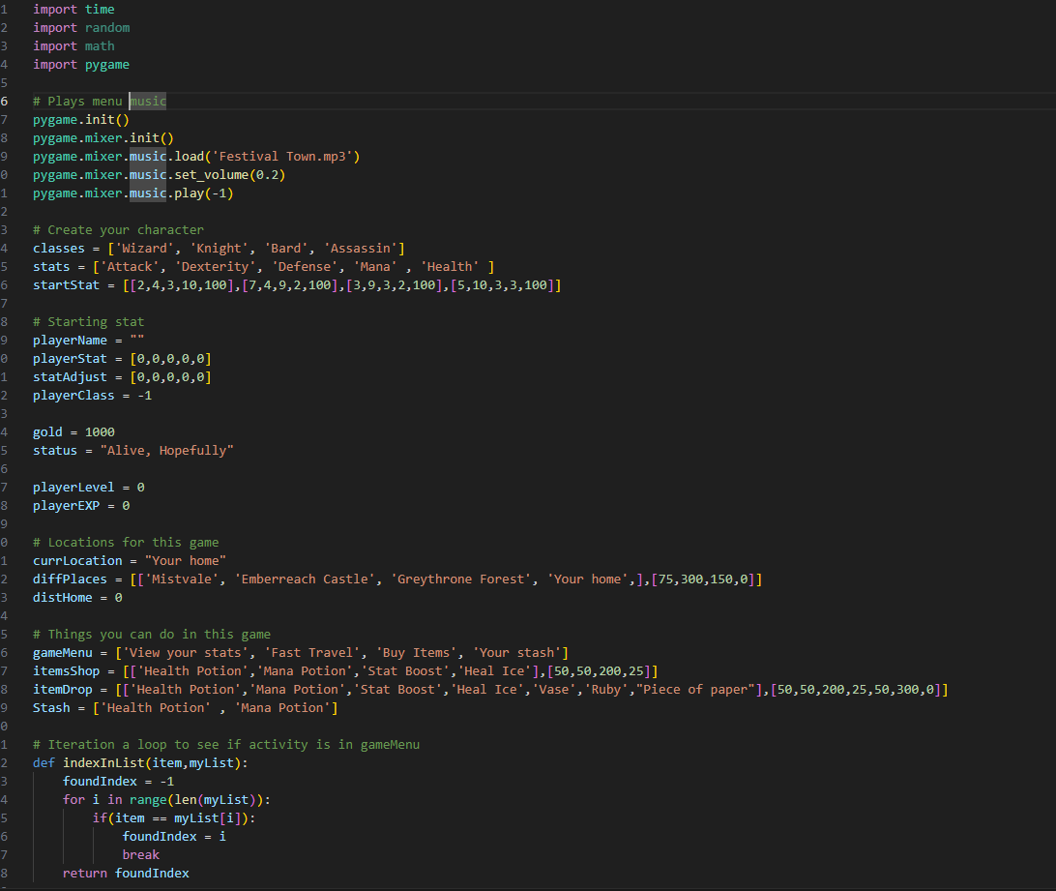
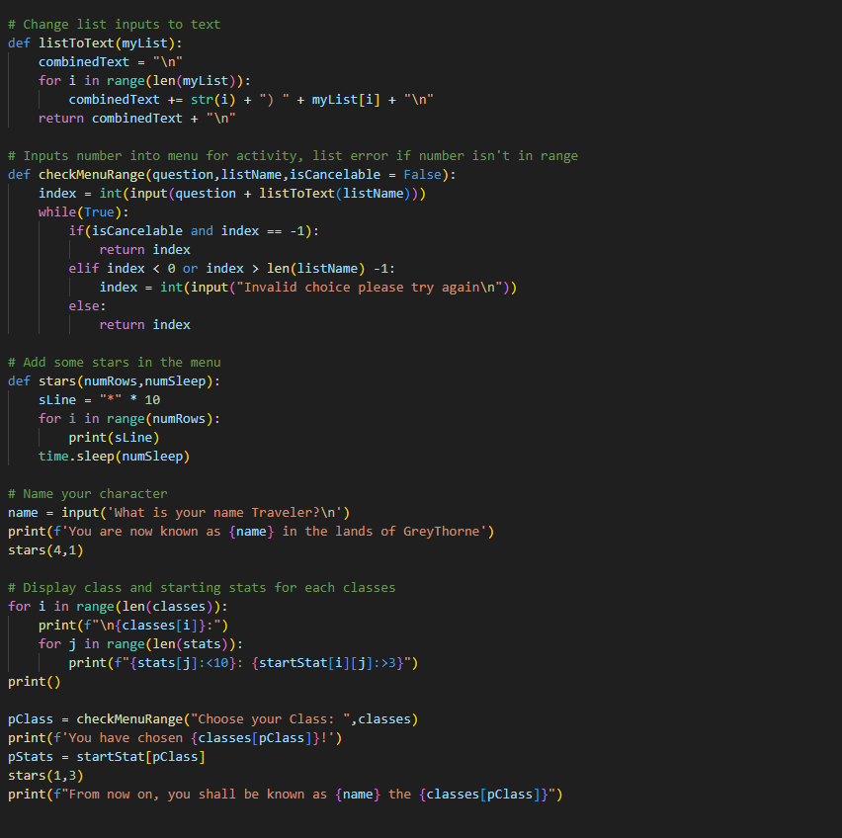
The code

Slide 4
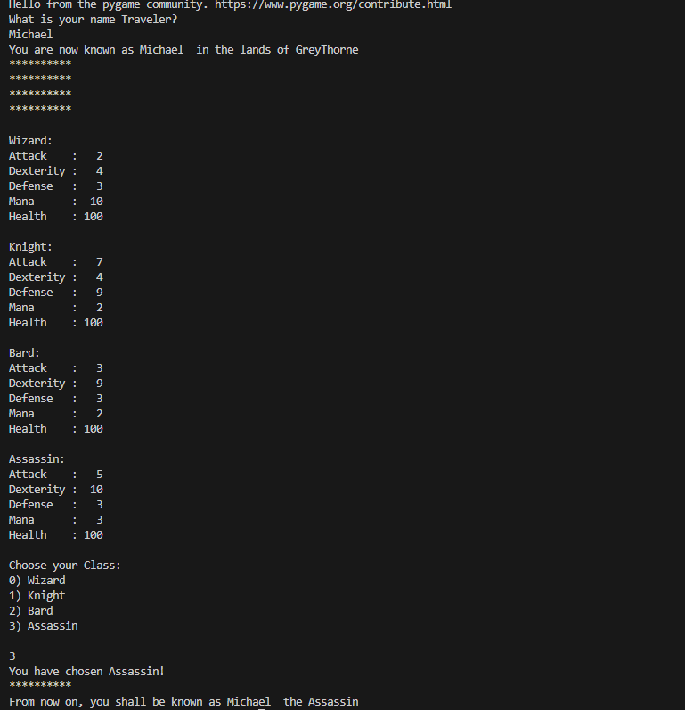
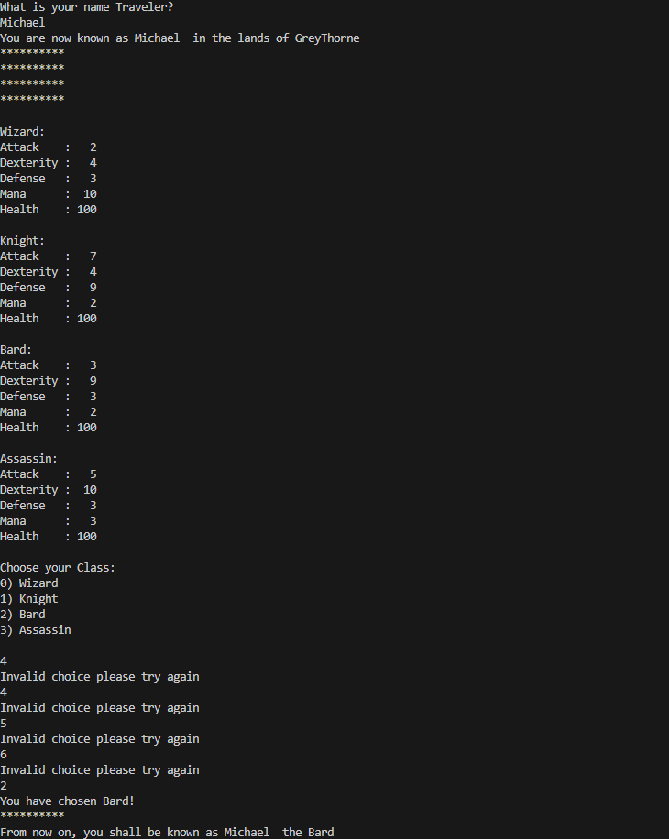
When it's running

Slide 5
Next Sprint
By the next 2 weeks, We wanted to implement more of the traveling done for this game, being able to buy and sell item based on the item you pick up during the game, include random pickup for this game and maybe create new enemies and boss for each of the locations.
I will be working on the random pickup for this game, Chris will be working on the travel system for this game, and we will both plan and work on the enemies and bosses. We need to also produce a story for the game since we haven’t plan about the story too much yet, but we will when we continue to code this game.

